Slide 1
2
DERIVATIVES

Slide 2
DERIVATIVES
2.1
Derivatives and
Rates of Change
In this section, we will learn:
How the derivative can be interpreted as a rate
of change in any of the sciences or engineering.
Notes:
The slope of tangent line as the limit of slopes of secant lines
Physical examples of instantaneous rates of change and their unit.
The derivative notation f’(a) and meaning of its.
Using f’ to write an equation of the tangent line to a curve at a given point.
Using f’ as an approximate rate of change when working with discrete data.

Slide 3
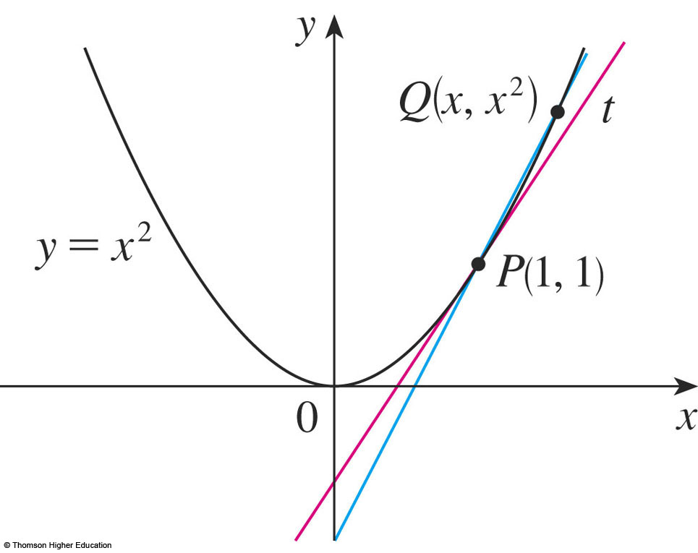
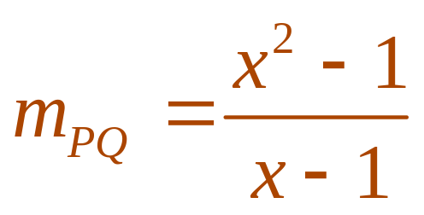
THE TANGENT PROBLEM
Example 1
  Find an equation of the tangent line to the parabola
  y = x² at the point P(1,1).
    We will be able to find an equation of the tangent line as soon as we know its slope m.
Notes:
The slope of tangent line as the limit of slopes of secant lines
m=tanα=tan(PQ,Ox)

Slide 4
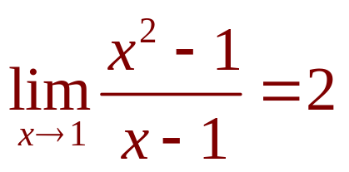
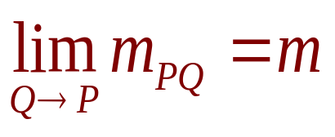
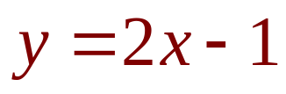
THE TANGENT PROBLEM
Example 1
The slope of the tangent line is said to be the limit of the slopes of the secant lines.
  The equation of the tangent line through (1, 1) as:

Slide 5
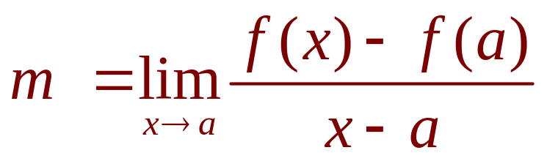
TANGENTS
1. Definition
The tangent line to the curve y = f(x) at the point P(a, f(a)) is the line through P with slope
provided that this limit exists.

Slide 6

THE VELOCITY PROBLEM
Example 3
  Investigate the example of a falling ball.
    Suppose that a ball is dropped
    from the upper observation
    deck of the CN Tower in
    Toronto, 450 m above the
    ground.
    Find the velocity of the ball
    after 5 seconds.
Notes:
Instantaneous velocity

Slide 7
THE VELOCITY PROBLEM
Example 3
If the distance fallen after t seconds is denoted by s(t) and measured in meters, then Galileo’s law is expressed by the following equation.
s(t) = 4.9t²
Notes:
s(t) = 0,5 g.t²

Slide 8
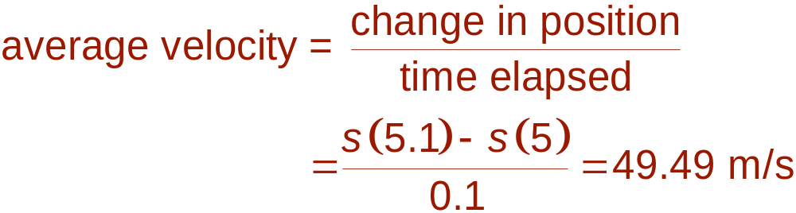
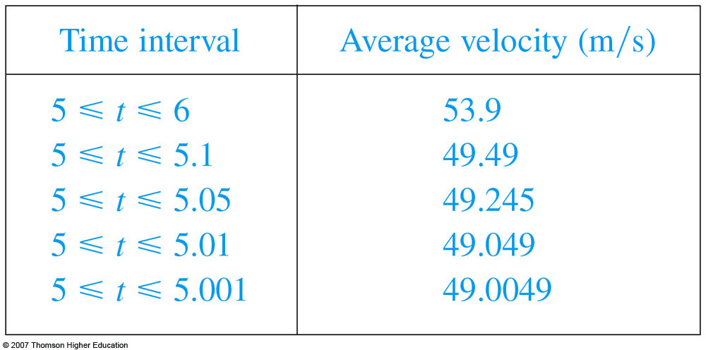
THE VELOCITY PROBLEM
  Thus, the (instantaneous)
  velocity after 5 s is:
  v = 49 m/s

Slide 9
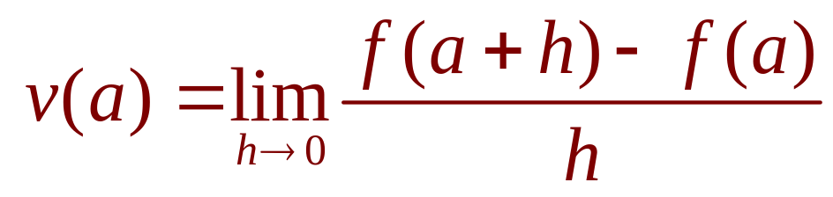
VELOCITIES
3. Definition
We define the velocity (or instantaneous velocity) v(a) at time t = a to be the limit of these average velocities:
Notes:
What is f(x)?

Slide 10
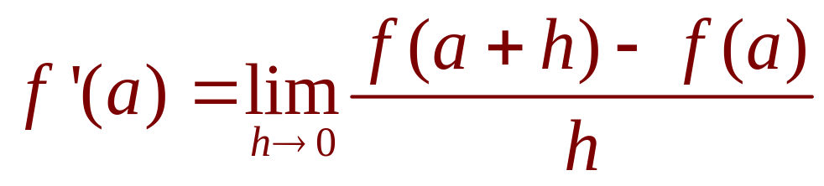
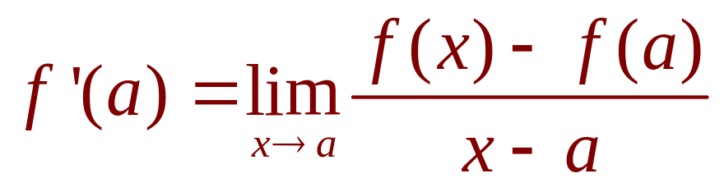
DERIVATIVES
4. Definition
The derivative of a function f at a number a, denoted by f’(a), is:
if this limit exists. Or
Notes:
Meaning of f’(a)?

Slide 11
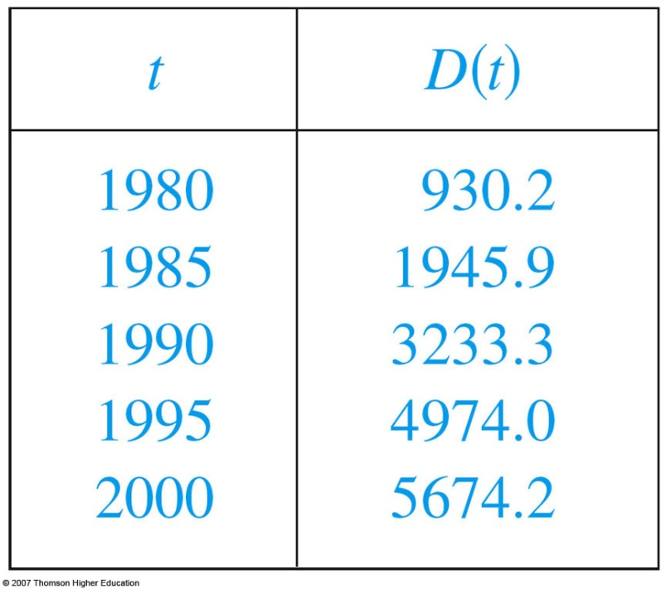
RATES OF CHANGE
Example 7
Let D(t) be the US national debt at time t. The table gives approximate values of this function by providing end-of-year estimates, in billions of dollars, from 1980 to 2000.
Interpret and estimate the value of D’(1990).
The derivative D’(1990) means the rate of
change of D with respect to t when t =1990,
that is, the rate of increase of the national
debt in 1990.
Notes:
Using f’ as an approximate rate of change when working with discrete data.

Slide 12
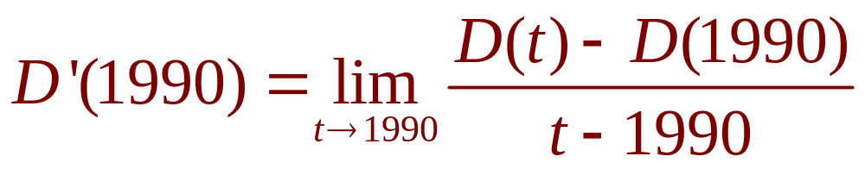
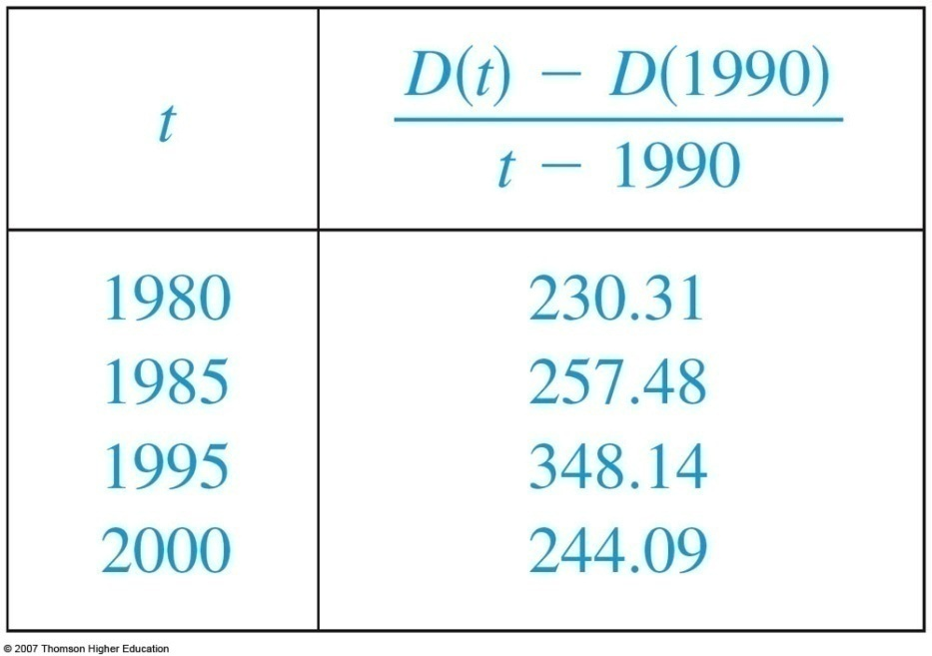

RATES OF CHANGE
Example 7
By Equation 5,
So, we compute and tabulate values of the difference quotient as follows.
Notes:
Using f’ as an approximate rate of change when working with discrete data.

Slide 13


RATES OF CHANGE
Example 7
We estimate that the rate of increase of
the national debt in 1990 was the average of
these two numbers—namely
billion dollars per year.

Slide 14
DERIVATIVES
2.2
The Derivative as a Function
In this section, we will learn about:
The derivative of a function f.
Notes:
The concept of a differentiable function interpreted graphically, algebraically and descriptive.
Obtaining the derivative function f’ by first considering the derivative at a point a and then a:= a variable such as x.
How a function can fail to be differentiable.
Second and higher derivatives.

Slide 15

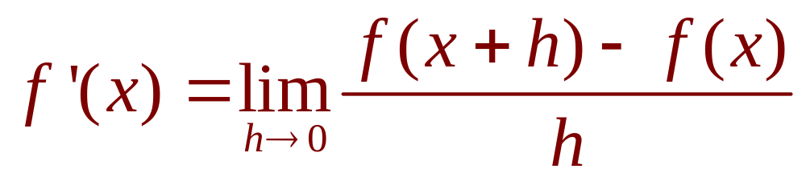
DERIVATIVES
1. Equation
In the preceding section, we considered the derivative of a function f at a fixed number a:
If we replace a in Equation 1 by a variable x, we obtain:
Notes:
f‘(a) is a number; f’(x) is a function

Slide 16
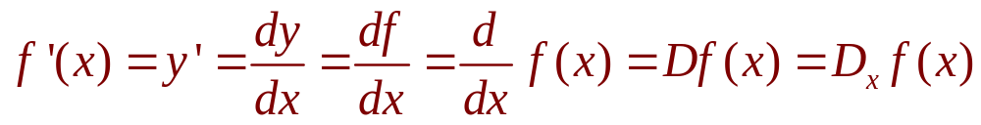
OTHER NOTATIONS
Some common alternative notations for the derivative are as follows:
The symbols D and d/dx are called differentiation operators.
The symbol dy/dx is called Leibniz notation

Slide 17
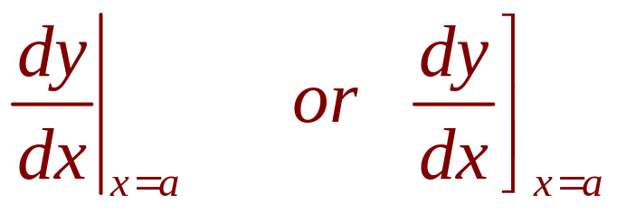
OTHER NOTATIONS
If we want to indicate the value of a derivative dy/dx in Leibniz notation at a specific number a, we use the notation
which is a synonym for f’(a).

Slide 18
OTHER NOTATIONS
3. Definition
A function f is differentiable at a if f’(a) exists.
It is differentiable on an open interval D if it is differentiable at every number in the interval D.

Slide 19
HOW CAN A FUNCTION FAIL TO BE DIFFERENTIABLE?
Theorem
If f is differentiable at a,
then f is continuous at a.
This theorem states that, if f is not continuous at a, then f is not differentiable at a.
Notes:
“<=“ is false: y = |x| is continuous at 0 but it is not differentiable at 0.

Slide 20
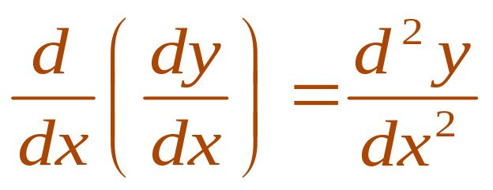
HIGHER DERIVATIVES
If f is a differentiable function, then its derivative f’ is also a function.
So, f’ may have a derivative of its own, denoted by
(f’)’= f’’.
This new function f’’ is called the second derivative of f.

Slide 21
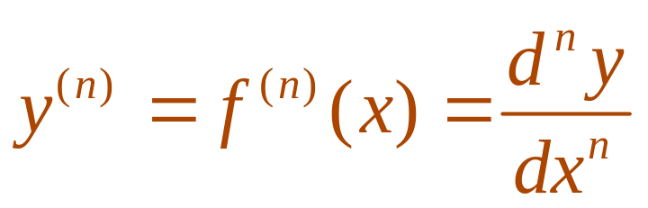
HIGHER DERIVATIVES
The process can be continued.
  In general, the nth derivative of f is denoted by f^{(n)} and is obtained from f by differentiating n times.
  If y = f(x), we write:

Slide 22
DERIVATIVES
2.3,4,5,6
Differentiation Formulas
In this section, we will learn:
How to differentiate constant functions,
power functions, polynomials, and
exponential functions.
Notes:
The computation of derivatives using the power, constant multiple, sum, difference, product and quotient rules.
The normal line to a curve at a point.

Slide 23
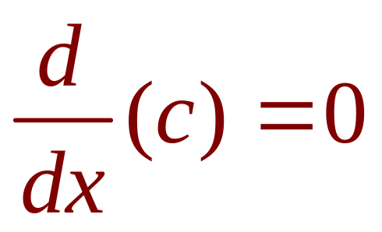
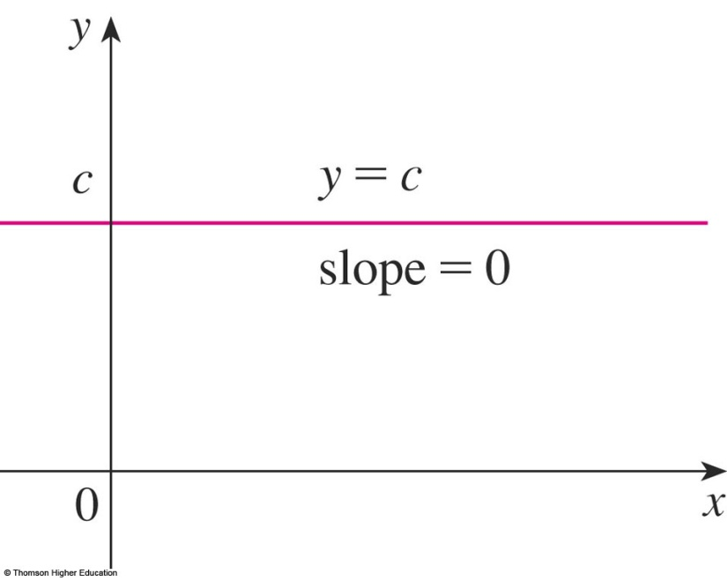
CONSTANT FUNCTION—DERIVATIVE
In Leibniz notation, we write this rule as follows.
(Reference Pages, p.5)
Notes:
e is constant

Slide 24
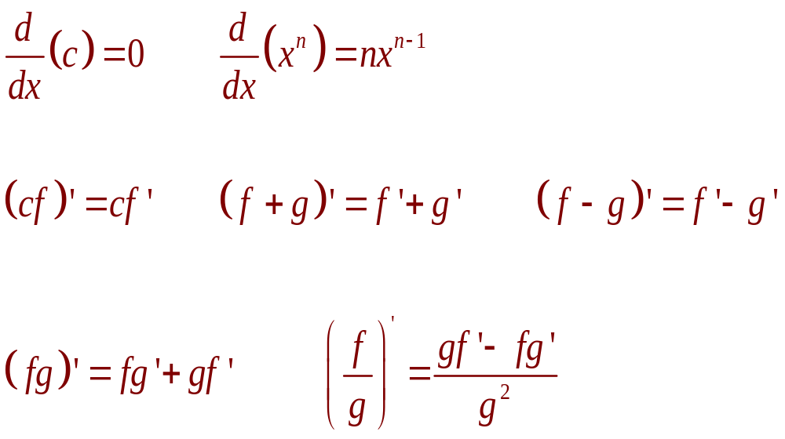
DIFFERENTIATION FORMULAS
Here’s a summary of the differentiation formulas we have learned so far.

Slide 25

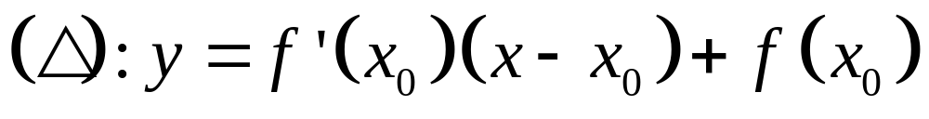
Tangent line (Δ) equation at M(x,y) (C): y = f(x)

Slide 26
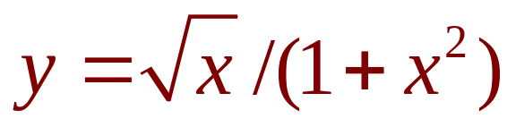
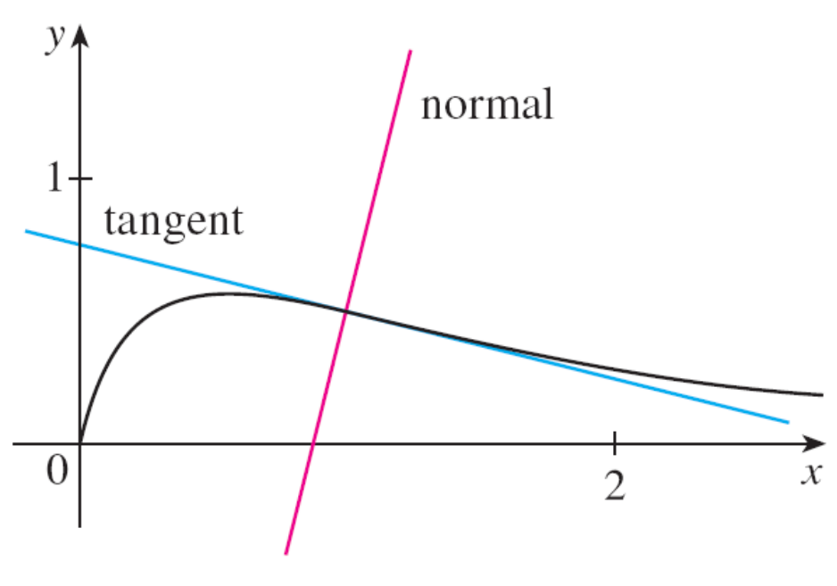
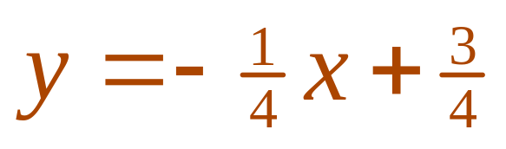
TANGENT AND NORMAL LINES
Example 12
Find equations of the tangent line and normal line to the curve
at the point (1, ½).
© Thomson Higher Education
Notes:
The normal line is defined as the line that is perpendicular to the tangent line at the point of tangency.

Slide 27
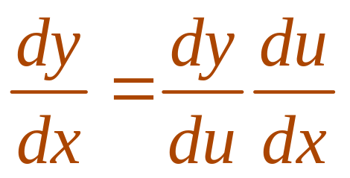
THE CHAIN RULE
If g is differentiable at x and f is differentiable at g(x), the composite function F = f ◦ g is differentiable at x and F’ is given by the product:
F’(x) = f’(g(x)) • g’(x)
  In Leibniz notation, if y = f(u) and u = g(x) are both differentiable functions, then:
Notes:
dy/dx is y’ dependent on x
dy/du is y’ dependent on u
du/dx is u’ dependent on x
“/” is not division.

Slide 28
Let f(x)=g(sin3x). Find f’ in terms of g’.
A | 3cos3xg’(x)
B | 3cos3xg’(sin3x)
C | cos3xg’(sin3x)
Answer: b

Slide 29
Suppose h(x)=f(g(x)) and f(2)=3, g(2)=1, g’(2)=1, f’(2)=2, f’(1)=5. Find h’(2).
A | 1
B | 2
C | 3
D | 4
E | 5
Answer: e

Slide 30
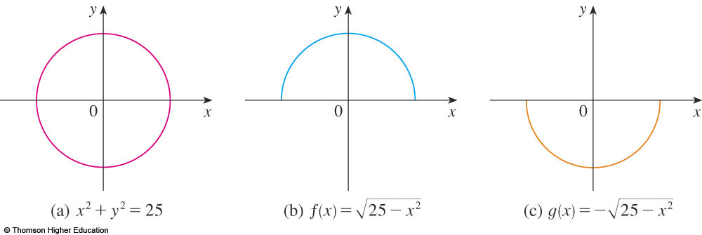
IMPLICIT DIFFERENTIATION
The graphs of f and g are the upper and lower semicircles of the circle
x² + y² = 25.
Notes:
What is implicit function?
The technique of implicit differentiation

Slide 31
IMPLICIT DIFFERENTIATION METHOD
Instead, we can use the method of implicit differentiation.
  This consists of differentiating both sides of the equation with respect to x and then solving the resulting equation for y’.

Slide 32
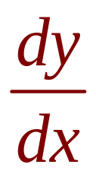
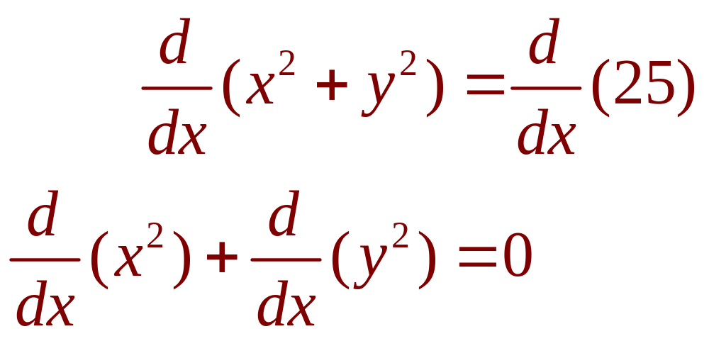
IMPLICIT DIFFERENTIATION
Example 1
a. If x² + y² = 25, find .
b. Find an equation of the tangent to the circle x² + y² = 25 at the point (3, 4).

Slide 33
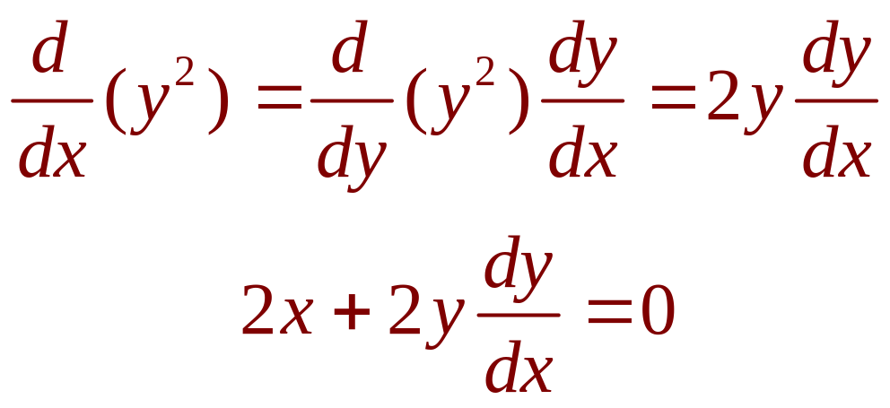
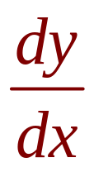
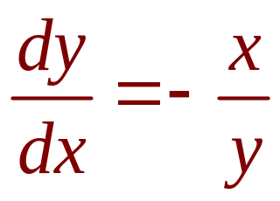
IMPLICIT DIFFERENTIATION
Example 1 a
Remembering that y is a function of x and using the Chain Rule, we have:
Then, we solve this equation for :

Slide 34
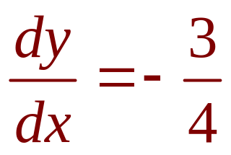
IMPLICIT DIFFERENTIATION
E. g. 1 b—Solution 1
At the point (3, 4) we have x = 3 and y = 4.
So,
  Thus, an equation of the tangent to the circle at (3, 4)
  is: y – 4 = – ¾(x – 3) or 3x + 4y = 25.

Slide 35
IMPLICIT DIFFERENTIATION
Example 4
Find y” if x⁴ + y⁴ = 16.
Differentiating the equation implicitly with respect to x, we get 4x³ + 4y³y’ = 0.

Slide 36
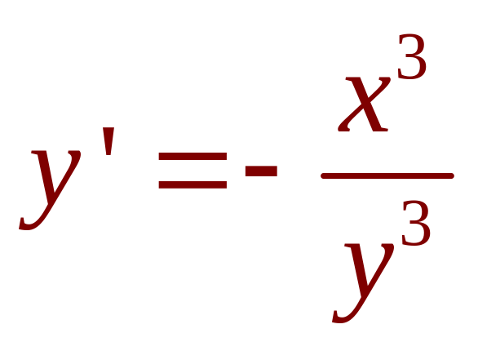
IMPLICIT DIFFERENTIATION
E. g. 4—Equation 3
Solving for y’ gives:

Slide 37
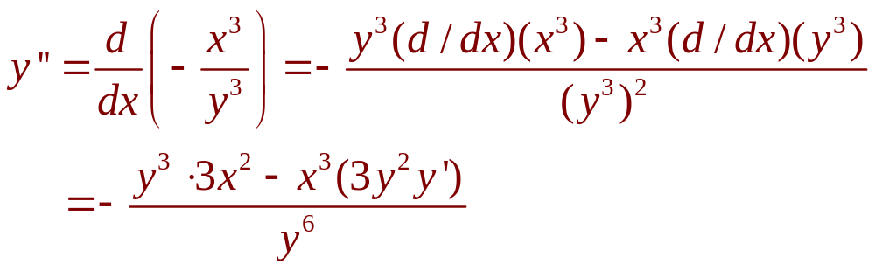
IMPLICIT DIFFERENTIATION
Example 4
To find y’’, we differentiate this expression
for y’ using the Quotient Rule and remembering that y is a function of x:

Slide 38
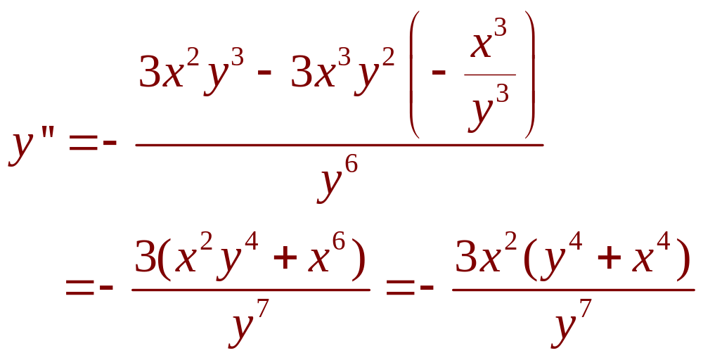
IMPLICIT DIFFERENTIATION
Example 4
If we now substitute Equation 3 into
this expression, we get:

Slide 39
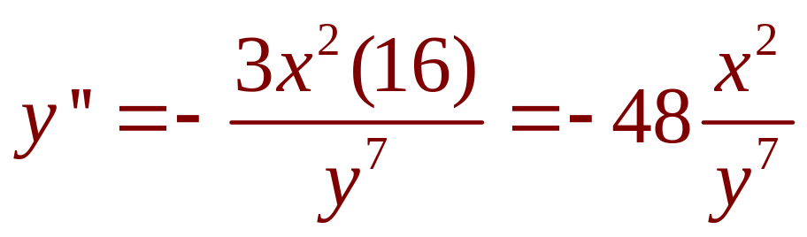
IMPLICIT DIFFERENTIATION
Example 4
However, the values of x and y must satisfy the original equation x⁴ + y⁴ = 16.
So, the answer simplifies to:

Slide 40
DERIVATIVES
2.7
Related Rates
In this section, we will learn:
How to compute the rate of change of one quantity
in terms of that of another quantity.

Slide 41
STRATEGY
It is useful to recall some of the problem-solving principles from Chapter 1 and adapt them to related rates in light of our experience in Examples 1–3.
  Read the problem carefully.
  Draw a diagram if possible.
  Introduce notation. Assign symbols to all quantities that are functions of time.
  (…, p.129)

Slide 42
RELATED RATES
Example 1
Air is being pumped into a spherical balloon so that its volume increases at a rate of
100 cm³/s.
How fast is the radius of the balloon increasing when the diameter is 50 cm?
Notes:
List quantities: V, r, t
V in terms of r and t
r in terms of t.

Slide 43
Example 1
The key thing to remember is that rates of change are derivatives.
  In this problem, the volume and the radius are
  both functions of the time t.
  The rate of increase of the volume with respect
  to time is the derivative dV / dt.
  The rate of increase of the radius is dr / dt.

Slide 44
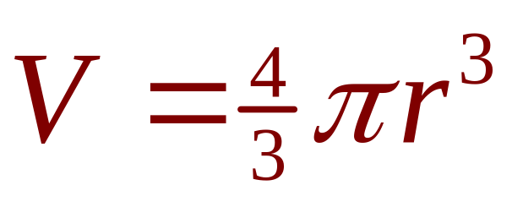
RELATED RATES
Example 1
To connect dV/dt and dr/dt, first
we relate V and r by the formula for
the volume of a sphere:

Slide 45
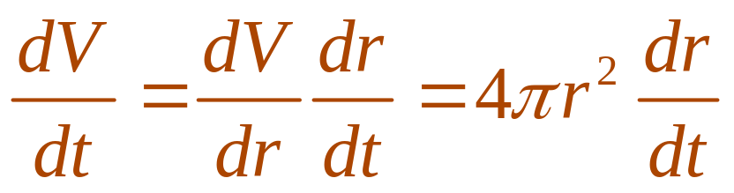
Example 1
To use the given information, we differentiate each side of the equation with respect to t.
  To differentiate the right side, we need to use
  the Chain Rule:

Slide 46
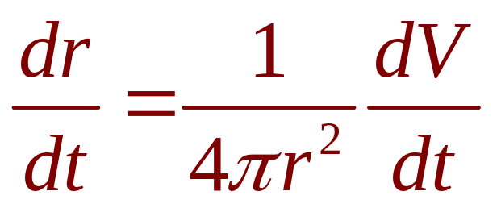
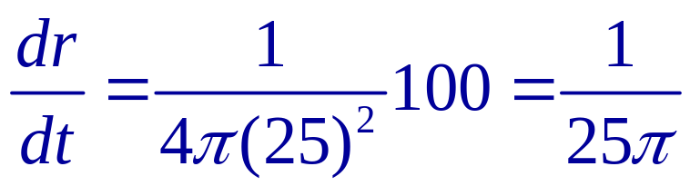
RELATED RATES
Example 1
Now, we solve for the unknown quantity:
  If we put r = 25 and dV / dt = 100 in this equation,
  we obtain:
  The radius of the balloon is increasing at the rate
  of 1/(25π) ≈ 0.0127 cm/s.

Slide 47
Example 2
A ladder 10 ft long rests against a vertical wall.
If the bottom of the ladder slides away
from the wall at a rate of 1 ft/s, how fast is
the top of the ladder sliding down the wall when the bottom of the ladder is 6 ft from
the wall?

Slide 48
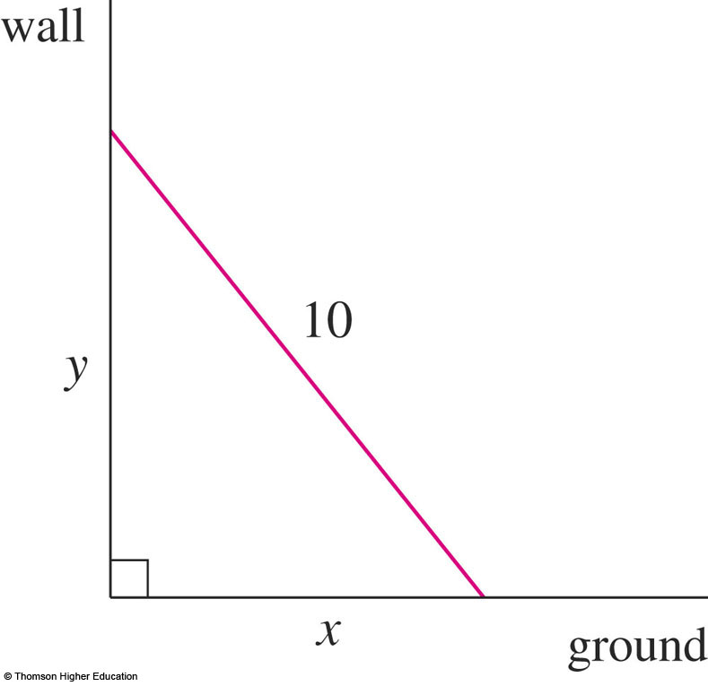
Example 2
We first draw a diagram and label it
as in the figure.
  Let x feet be the distance from the bottom of the ladder to the wall and y feet the distance from the top of the ladder to the ground.
  Note that x and y are
  both functions of t
  (time, measured in
  seconds).

Slide 49
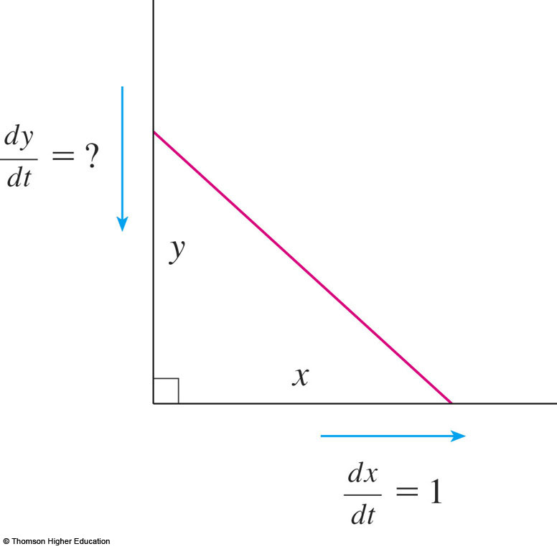
Example 2
We are given that dx / dt = 1 ft/s
and we are asked to find dy / dt
when x = 6 ft.

Slide 50
Example 2
In this problem, the relationship between
x and y is given by the Pythagorean Theorem: x² + y² = 100

Slide 51
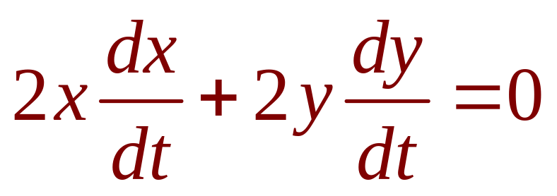
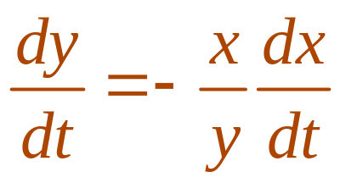
Example 2
Differentiating each side with respect to t using the Chain Rule, we have:
  Solving this equation for the desired rate,
  we obtain:

Slide 52
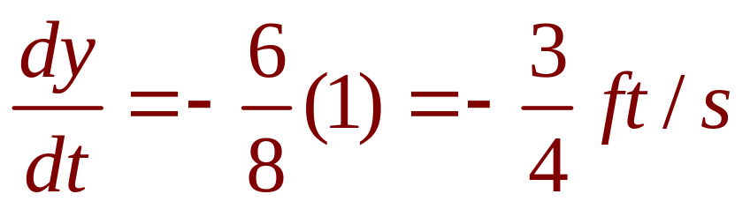
Example 2
When x = 6 , the Pythagorean Theorem gives y = 8 and so, substituting these values and
dx / dt = 1, we have:
  The fact that dy / dt is negative means that
  the distance from the top of the ladder to
  the ground is decreasing at a rate of ¾ ft/s.
  That is, the top of the ladder is sliding down
  the wall at a rate of ¾ ft/s.

Slide 53
DERIVATIVES
2.8
Linear Approximations
and Differentials
In this section, we will learn about:
Linear approximations and differentials
and their applications.
Notes:
The general equation of a line tangent to the graph of a function, and its use in approximating that function near a point.
The differential as the difference between the linearization of a function and that function.

Slide 54
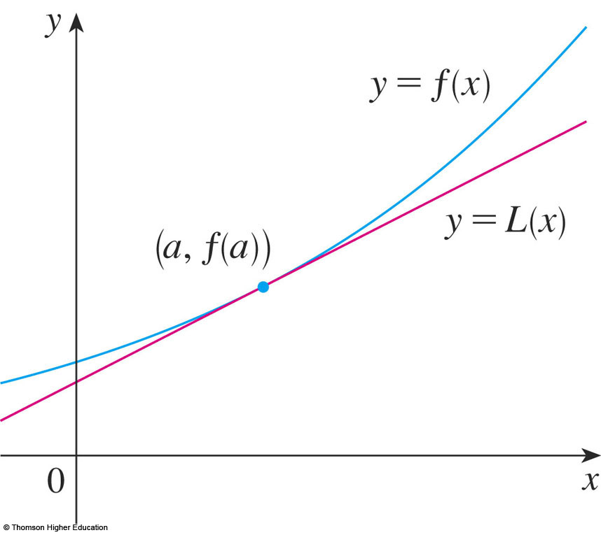
LINEAR APPROXIMATIONS
We use the tangent line at (a, f(a)) as an approximation to the curve y = f(x) when x is near a.
  An equation of
  this tangent line is
  L(x) = y = f(a) + f’(a)(x - a)

Slide 55
LINEAR APPROXIMATION
Equation 1
The approximation
f(x) ≈ f(a) + f’(a)(x – a) = L(x)
is called the linear approximation of f at a.

Slide 56
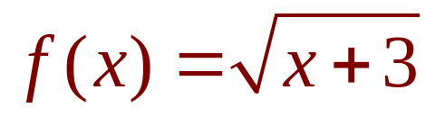
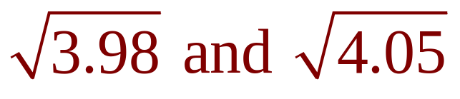
LINEAR APPROXIMATIONS
Example 1
Find the linearization of the function
at a = 1 and use it to approximate the numbers
Are these approximations overestimates or underestimates?
Notes:
select the appropriate function, in this case such that f(x) = x^{1/2}

Slide 57


LINEAR APPROXIMATIONS
Example 1
Putting these values into Equation 2, we see that the linearization is:

Slide 58


LINEAR APPROXIMATIONS
Example 1
The corresponding linear approximation is:
(when x is near 1)
In particular, we have:

Slide 59

LINEAR APPROXIMATIONS
Look at the table and the figure.
  The tangent line
  approximation
  gives good
  estimates if x
  is close to 1.
  However,
  the accuracy decreases
  when x is farther away from 1.

Slide 60




Use the linear approximation to of the function at
a=3 to approximate the numbers. Select the correct ones.
a) b)
c) d)
Answer: a and b

Slide 61
DIFFERENTIALS
Example 4
The radius of a sphere was measured
and found to be 21 cm with a possible error
in measurement of at most 0.05 cm.
What is the maximum error in using this
value of the radius to compute the volume
of the sphere?
Notes:
Differential of y=f(x) is dy = f’(x)dx

Slide 62
DIFFERENTIALS
Example 4
If the radius of the sphere is r, then
its volume is V = 4/3πr³.
  If the error in the measured value of r
  is denoted by dr = ∆r, then the corresponding
  error in the calculated value of V is ∆V.

Slide 63
DIFFERENTIALS
Example 4
This can be approximated by the differential
dV = 4πr²dr
When r = 21 and dr = 0.05, this becomes:
dV = 4π(21)² 0.05 ≈ 277
  The maximum error in the calculated volume
  is about 277 cm³.

Slide 64

RELATIVE ERROR
Note
Relative error is computed by dividing
the error by the total volume:
  Thus, the relative error in the volume is about
  three times the relative error in the radius.

Slide 65
RELATIVE ERROR
Note
In the example, the relative error in the radius
is approximately dr/r = 0.05/21 ≈ 0.0024
and it produces a relative error of about 0.007 in the volume.
  The errors could also be expressed as
  percentage errors of 0.24% in the radius
  and 0.7% in the volume.

Slide 66


Quiz
Find the limit if
.
a. 1 b. ½ c. 1/3 d. 2
Notes:
This is (lnx)’

Slide 67



Quiz
Find when x=2 if
a. 1 b.2 c.3 d.4 e.0
Notes:
Chain rule

Slide 68
Quiz
The equation of the tangent line to the curve y= x - sin x at (∏, ∏)
is
y=0 b) y=2x c) y=2x-2
d) y=2x+2 e) None of the others
Answer: e

Slide 69
Quizzes
If 1/f =1/u+1/v then du/dv is:
f/(v-f)² b) –f²/(v-f)²
c) 2f²/(v-f)² d)-2f²/(v-f)²
e) None of the others
Answer: b

Slide 70
Exercises:
11,13 p81,p82
46,48 p.105
64,68 p.121
17,18,19 p.125,126
1,3,4,6 ,9,10 p.131
1,2,3,4, 21,22,23,24 p.137

Slide 71
Thanks

